Slide 2
Look at the answers. Podívej se na odpovědi.
Write the questions: Napiš otázku k odpovědi:
What is this? , Who is this? Where is it?
What is this?
This is a hippo. This is a pencil.
It’s on the table . This is Tom.
This is Ella. This is a cat.
It’s under the book. This is an apple.

Slide 3
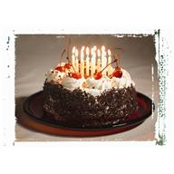
Něco za odměnu

Slide 4
http://office.microsoft.com/cs-cz/images/results.aspx?qu=dort&ex=1#ai:MP900382957|
http://office.microsoft.com/cs-cz/images/results.aspx?qu=dort&ex=1#ai:MC900410487|
http://office.microsoft.com/cs-cz/images/results.aspx?qu=dort&ex=1#ai:MC900413716|
http://office.microsoft.com/cs-cz/images/results.aspx?qu=dort&ex=1#ai:MC900412446|
http://office.microsoft.com/cs-cz/images/results.aspx?qu=dort&ex=1#ai:MC900309848|

