Slide 1
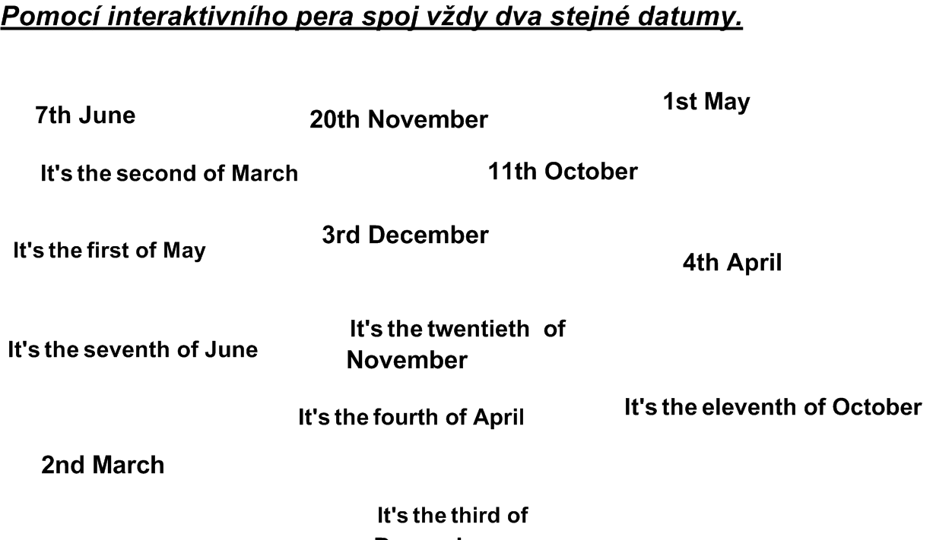



Slide 2
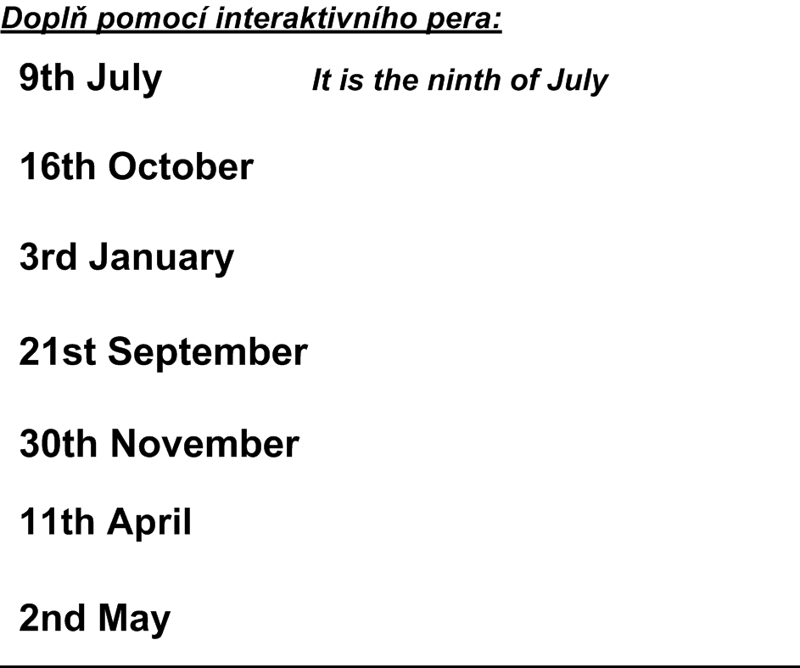



Slide 3

Kliparty použity z galerie firmy Microsoft Office
Anna Blažková
http://office.microsoft.com/cs-cz/images/results.aspx?qu=strom&ex=1#ai:MC900069883
http://office.microsoft.com/cs-cz/images/results.aspx?qu=slunce&ex=1#ai:MC900441790
http://office.microsoft.com/cs-cz/images/results.aspx?qu=vločka&ex=1#ai:MP900449089
http://office.microsoft.com/cs-cz/images/results.aspx?qu=stromy&ex=1#ai:MC900250097
http://office.microsoft.com/cs-cz/images/results.aspx?qu=r%C5%AF%C5%BEe&ex=1#ai:MC900281928|

