Slide 1

Neurčitý člen a, an
(ovoce a zelenina)
Anna Blažková

Slide 2



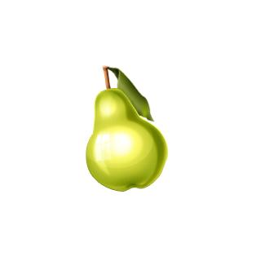

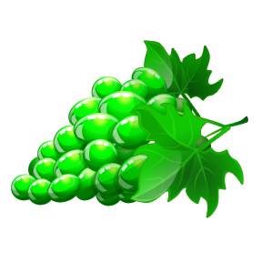

Pojmenuj obrázek a doplň neurčitý člen a, an
an orange
a strawberry
a banana
a pear
a peach
a grapes
an apple

Slide 3
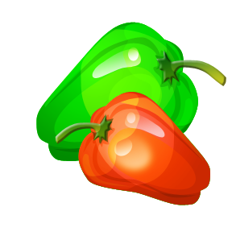

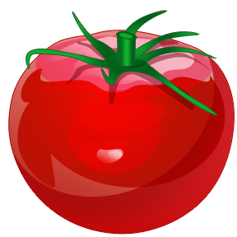
Pojmenuj obrázek a doplň neurčitý člen a, an
a cucumber
a pepper
a carrot
a potatoe
an onion
a tomato
a bean

Slide 4
Použité obrázky: Klipart Microsoft Office 2010
http://office.microsoft.com/cs-cz/images/results.aspx?qu=pomeranč&ex=1#ai:MC900441720
http://office.microsoft.com/cs-cz/images/results.aspx?qu=banány&ex=1#ai:MC900441718
http://office.microsoft.com/cs-cz/images/results.aspx?qu=jahoda&ex=1#ai:MC900436899
http://office.microsoft.com/cs-cz/images/results.aspx?qu=hru%C5%A1ka&ex=1#ai:MC900436906
http://office.microsoft.com/cs-cz/images/results.aspx?qu=broskev&ex=1#ai:MC900436905
http://office.microsoft.com/cs-cz/images/results.aspx?qu=hrozen&ex=1#ai:MC900441744
http://office.microsoft.com/cs-cz/images/results.aspx?qu=jablko&ex=1#ai:MC900441708
http://office.microsoft.com/cs-cz/images/results.aspx?qu=mrkev&ex=1#ai:MC900441780
http://office.microsoft.com/cs-cz/images/results.aspx?qu=okurek&ex=1#ai:MC900112422
http://office.microsoft.com/cs-cz/images/results.aspx?qu=paprika&ex=1#ai:MC900441782|
http://office.microsoft.com/cs-cz/images/results.aspx?qu=brambory&ex=1#ai:MC900331282
http://office.microsoft.com/cs-cz/images/results.aspx?qu=raj%C4%8De&ex=1#ai:MC900441781|
http://office.microsoft.com/cs-cz/images/results.aspx?qu=cibule&ex=1#ai:MC900112836|
http://office.microsoft.com/cs-cz/images/results.aspx?qu=fazole&ex=1#ai:MC900215377|

